Slide 1
Introduction Operating System Structure

Slide 2
Review
OS
Is a system software
Locates in kernel mode
Manage and make the efficiently and convenient to user about hardware and resource
Terminology
Kernel mode, User mode
Latency time
Switch user mode ↔ kernel mode
Switch CPU a process to other process together
Address space
File Management
File, Directory, Special file (block vs. character)
Pipe
I/O management
Share vs. Dedicated device, I/O software layer (device independent)
System Calls

Slide 3
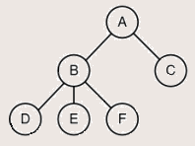
Review…
Process:
A program in execution
A program loaded into memory and executing
Associated with each process is set of resources such as executable code, data, stack, CPU registers value, PC, and other information needing to run a program
Associated with each process is its address space (i.e., all memory locations that the process can read and write)
Process table (array or linked list) stores all the information of processes
A process hierarchy (tree)
Tanenbaum, Fig. 1-13.

Slide 4
Objectives
OS Structures
Monolithic Systems
Layered Systems
Micro kernels
Client – Server Models
Virtual Machines

Slide 5
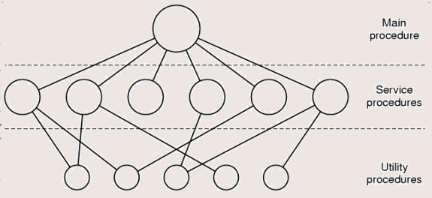
OS Structure Monolithic Systems
The entire OS runs as a single program in kernel mode
The OS is written as a collection of procedures, linked together into a single large executable binary program
A basic structure
A main program that invokes the requested service procedure.
A set of service procedures that carry out the system calls.
For each system call there is one service procedure that takes care of it and executes it
A set of utility procedures that
Help the service procedures.
Do things that are needed by several service procedures (e.g fetch data)
Tanenbaum, Fig. 1-24.

Slide 6
OS Structure Monolithic Systems
Disadvantages
Running a single program
Run only one single large executable binary program (not flexibility)
Do not protection, but hide information
The system is free to call any other ones
Can uses low level language (assembly)
Having thousands of procedure can call each other
Using procedure (static) → cannot manage user environments
Advantages
Simple (fast)
Ex: MS-DOS

Slide 7
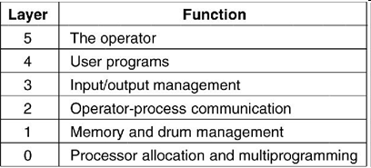
OS Structure Layered Systems
The OS is broken up into a number of layer, each built on top of lower
Assuming that the bottom layer is the hardware, and the highest layer is the user interface, layers are selected so that each one uses functions, operations and services of only lower-level layers.
Lower layers (usually called the kernel) contains the most fundamental functions to manage system resources.
There are 6 layers
Disadvantages
How many layers?
What’re functions?
Slow
Advantages
Easy to maintain, support, manage errors
Modularity, encapsulation
Ex: OS/2, Windows NT, Vista and Unix (describe the system, do not build the system)
Tanenbaum, Fig. 1-25.

Slide 8
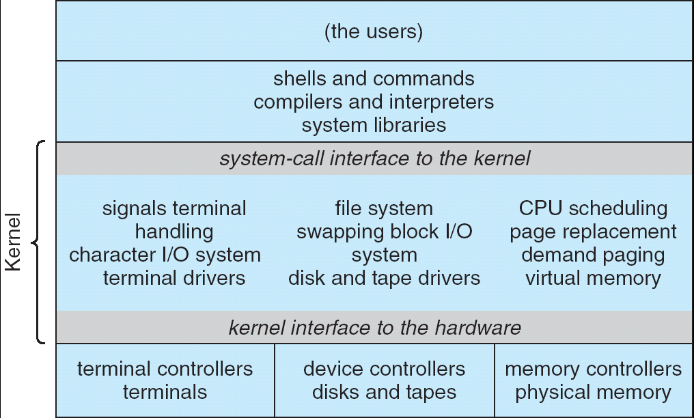
OS Structure Microkernels
OS Kernels have problems
10bugs/ 1000 lines code (buggy, bring down the system)
All the layers went in the kernel (complexity, large, and difficult to manage)

Slide 9
OS Structure Microkernels
Microkernels
Remove all nonessential components from the kernel, and implement them on user mode (splitting the OS into small, well-defined modules)
Running each task as an independent (separate) process → resist crashing the entire system
The modules run user mode → protection against bugs
Making a minimal kernel by put the mechanism for doing something in the kernel but not the policy (scheduling with highest priority process)
Provide a communication facility using message passing between the client program and the various series in user mode
Disadvantages
How to define the components are nonessential or essential? (depending on the design ideas or requirements)
Performance overhead of user space to kernel space communication
Advantages
Easy of extending and port the operating system to new architectures
Advance security and reliability (less code is running in kernel mode)
Ex: Symbian, Apple MacOS X Server

Slide 10
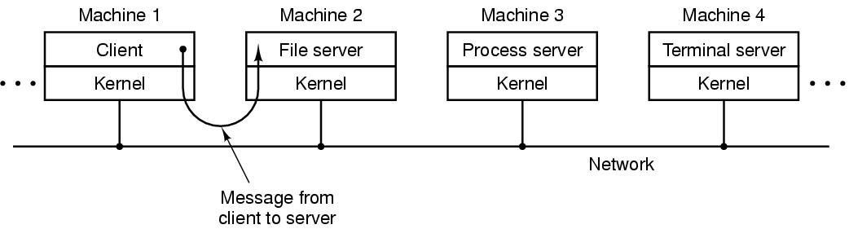
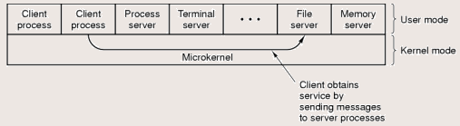
OS Structure Client – Server Model
Server provides some service that satisfy the client’s request
Client uses the server’s services
Message passing is used to communication
Can run on different or same computers
Tanenbaum, Fig. 1-27.

Slide 11
OS Structure Virtual Machines (VM)
Each virtual machine
Are not extended machine
Is identical to the true hardware (provide an exact duplicate of the underlying real machine)
Can run any OS that will run directly on the bare hardware at the same time
Software:
VMware Workstation, MS Virtual PC, Virtual Box, …
OS running on CD (Linux, Ubuntu …)
JVM (Java Virtual Machine):
Java compiler produces code through Java interpreter.
Can be shipped on Internet and run on the computer that has a JVM
Advantages
Completely protecting system resources, solving system compatibility system and do not disrupt the normal system operation
Disadvantages
Can not allocate all disks to VM

Slide 12
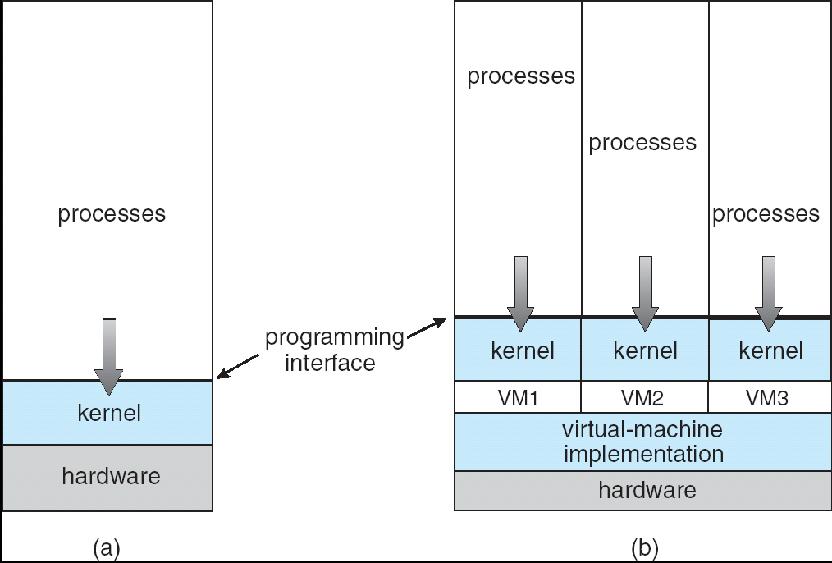
OS Structure Virtual Machines (VM)
(a) Nonvirtual machine (b) virtual machine
Virtual-machine implementation is called virtual machine monitor, or virtualization layer, or hypervisor

Slide 13
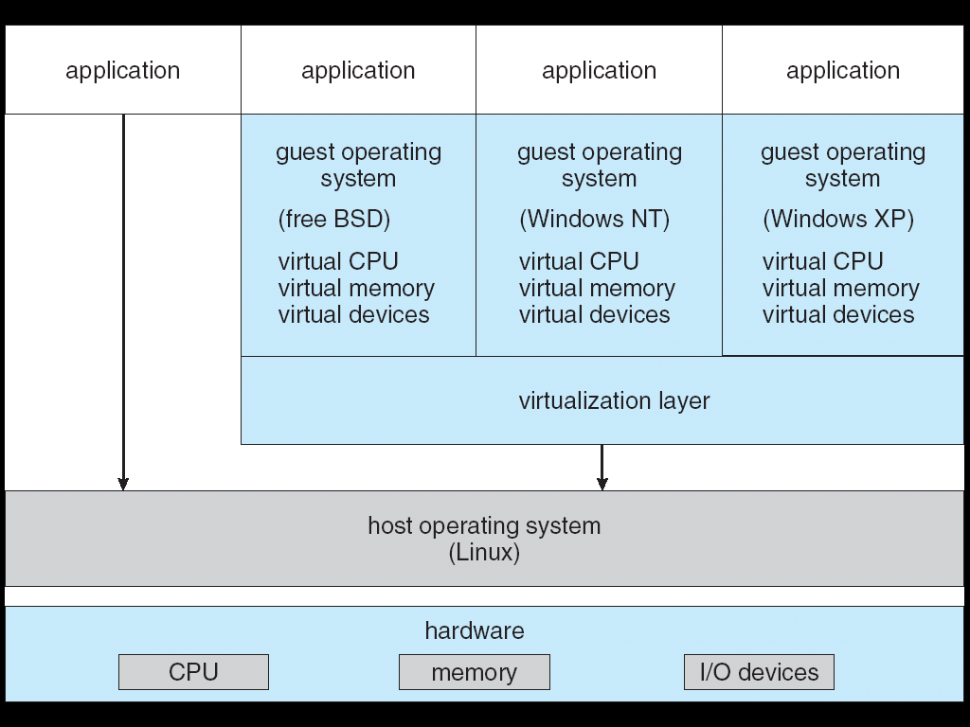
OS Structure Virtual Machines (VM)
VMWare Architecture

Slide 14
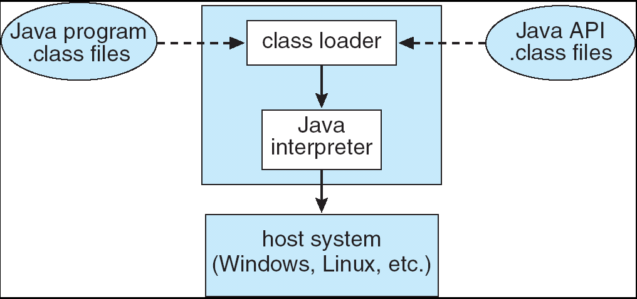
OS Structure Virtual Machines (VM)
JVM

Slide 15
OS Structure Exokernels
Is a program running in kernel mode
Giving each user a subset of the resource (instead of exact copying entire of underlying real machine)
Allocate resources to virtual machines and ensure the protection of them.
Moreover, exokernels make the VM thinking that it has its own disk (0 to maximum size of partition area)
Advantages
The exokernel scheme is saved a layer mapping
Need keep track of which virtual machine has been assigned which resource
Separate the multiprogramming in user mode (protection from real machine)
Less overhead because they keep the VM out of each other’s hair

Slide 16
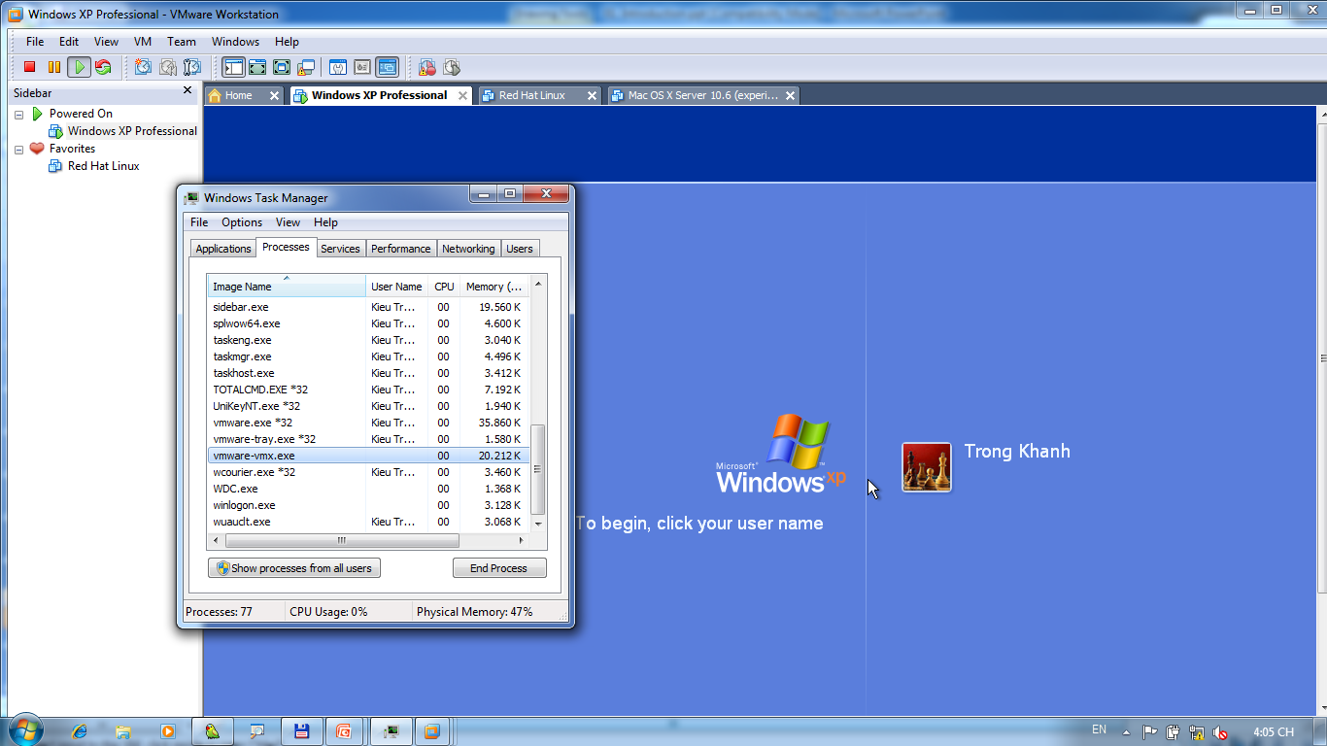
OS Structure Exokernels – Example

Slide 17
Summary
Operating System Concepts
System Calls
OS Structures
Q&A

Slide 18
Next Lecture
Processes
structure, mechanism, implementation, …
Threads
structure, mechanism, implementation, vs. Processes
IPC
How, comparatives, protection of processes/ threads

